Slide 1
PhD meeting review:
Principal Component Analysis
Jana & Jon
September 2019
Notes:
<number>

Slide 2
History
The earliest literature by Pearson (1901) and Hotelling (1933), independently
Became relevant when electronic computers came along
Extensive literature and two main concepts of obtaining the solutions as the eigen decomposition or as the singular value decomposition (SVD) of the centered matrix

Slide 3
General Idea
Dimensionality reduction method with minimal information loss
Used in exploratory data analysis, does not require distributional assumptions
Unsupervised learning
New uncorrelated variables: linear combination of existing variables (columns)
Find the directions of the maximum variance
1st principal component – largest variance, 2nd PC second largest variance,…
PCs are orthogonal
Notes:
<number>

Slide 4
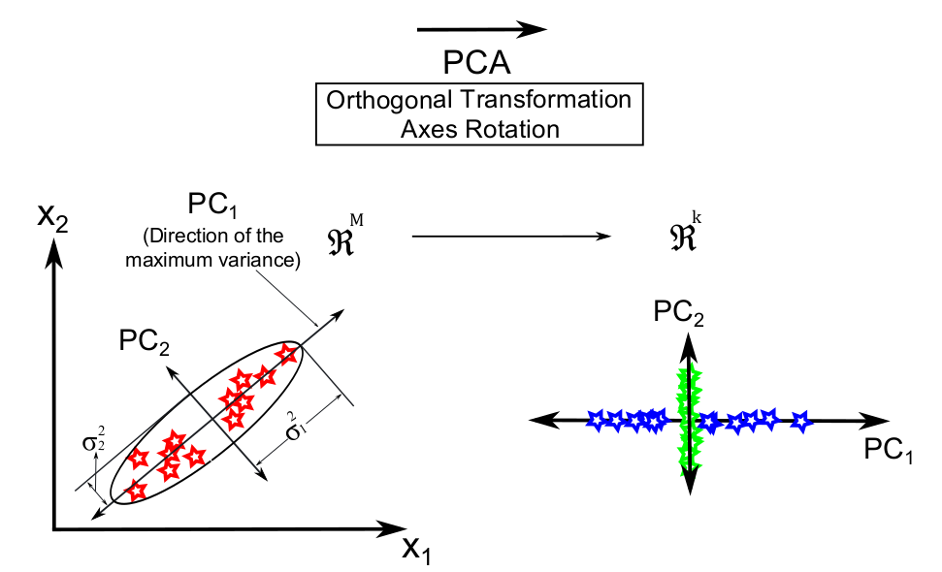

Slide 5
Computation methods
Eigen decomposition - values and eigenvectors
Square matrix
Singular value decomposition
Any matrix

Slide 6
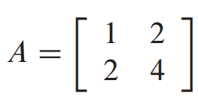
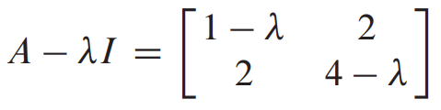
Eigenvalues and eigenvectors
Ax = λx x = eigenvector
λ = eigenvalue
λ as λI (A – λI)x = 0 det(A – λI) = 0
Solve: (1- λ)*(4-λ) – 2*2 = 0 →
eigenvalues→ eigenvector

Slide 7
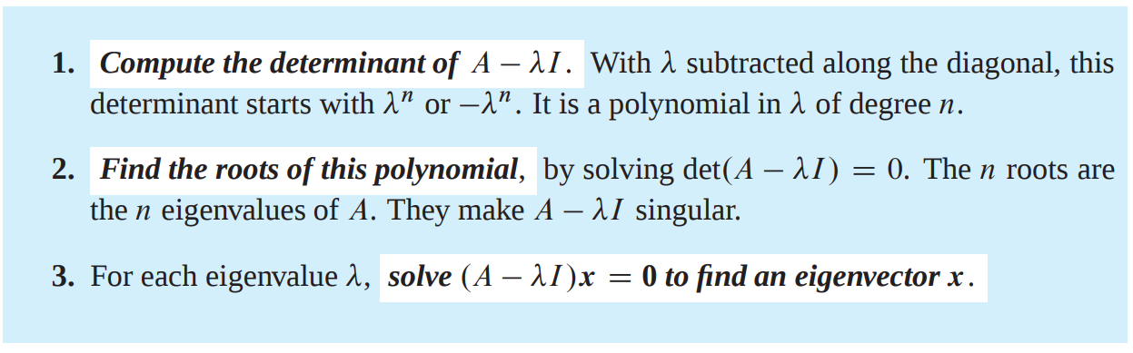
Eigenvectors are uncorrelated (covariance between the two linear combinations is 0) and orthonormal
Proportion of variance explained:

Slide 8
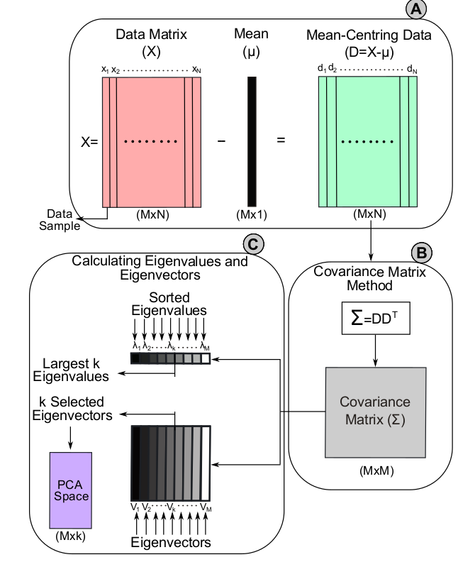
Input matrix → Covariance matrix
1. centre original variables (D)
2. compute covariance matrix DD^{T}
3. Compute eigenvalues and eigenvectors (any p× p real symmetric matrix, such as a covariance matrix S, has exactly p real eigenvalues)
Covariance –> Correlation matrix (avoid unit problems)
1. centre AND standardise the original matrix
2. the covariance matrix of standardised dataset = correlation matrix of original dataset

Slide 9
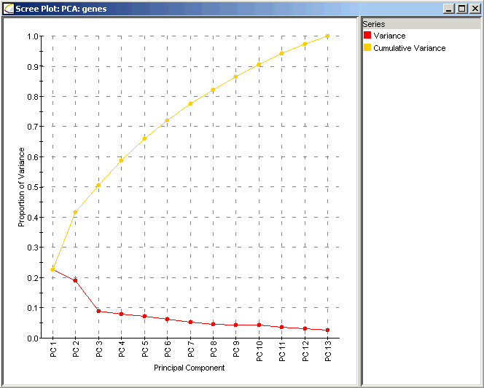

Slide 10
Calculating PCs using Covariance Matrix Method
Notes:
Prepare the data :
Center the data : subtract the mean from each variables. This produces a data set whose mean is zero.
Scale the data : If the variances of the variables in your data are significantly different, it’s a good idea to scale the data to unit variance. This is achieved by dividing each variables by its standard deviation.
Calculate the covariance/correlation matrix
Calculate the eigenvectors and the eigenvalues of the covariance matrix
Choose principal components : eigenvectors are ordered by eigenvalues from the highest to the lowest. The number of chosen eigenvectors will be the number of dimensions of the new data set. eigenvectors = (eig_1, eig_2,…, eig_n)
Compute the new dataset :
transpose eigeinvectors : rows are eigenvectors
transpose the adjusted data (rows are variables and columns are individuals)
new.data = eigenvectors.transposed X adjustedData.transposed
<number>

Slide 11
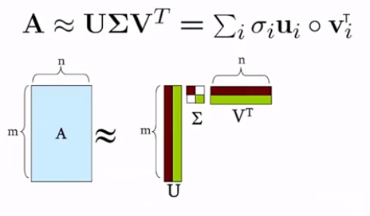
Singular value decomposition
Factorisation: matrix X → product of 3 matrices
X = UDV^{T}
input: X_{[m x n]}
U_{[m x r]} = left singular vectors; r = concepts
D_{[r x r]} = singular values, diagonal, sorted (strength of each concept)
V^{T}_{[n x r]} = right singular vectors
Maximum number of r is the min(m, n)

Slide 12
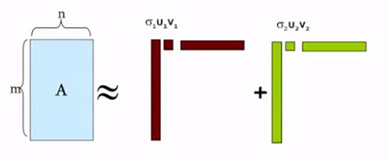
SVD theorem
Jure Leskovec, Stanford University
YT: Artificial Intelligence - All in One
U, D, V = unique
U, V = column orthonormal
Columns are orthogonal (dot product is 0) unit vectors (Euclidian length of 1)
U^{T}U = I, V^{T}V = I (form a basis)
D = diagonal, singular values are positive and sorted in decreasing order

Slide 13
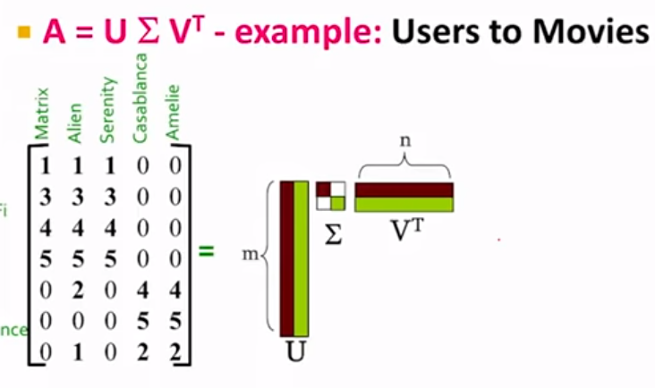
SVD - example
Movies
Trying to find:
concepts / latent dimensions / latent factors
Users

Slide 14
SVD - example

Slide 15
SVD - example
Sci-Fi
Romance

Slide 16
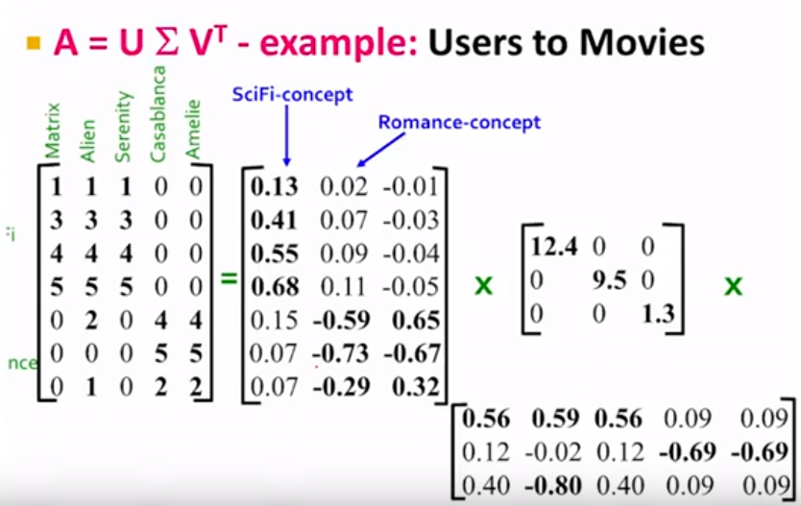
SVD - example
Columns of U = concepts
User to concept matrix

Slide 17
SVD - example
D = strength of the concept

Slide 18
SVD - example
V^{T} = rows are concepts
Movie to concept matrix

Slide 19
SVD - example
SVD gives us the best axis to project on
Standard deviation (spread) on the axis 1
Axis 1 of projection

Slide 20
SVD - PCA
X_{[m x n]}
U_{[m x r]}: y variable to concepts matrix
- columns = left singular vectors = concepts = eigenvectors of m x m matrix X’X
D: strength of our concept → sqrt(eigenvalues)
V_{[n x r]}: x variable to concepts matrix
- columns = right singular vectors = concepts = eigenvectors of n x n matrix XX’

Slide 21
SVD - PCA
X_{[m x n]}
U_{[m x r]}: x variable to concepts matrix
- columns = left singular vectors = concepts = eigenvectors of m x m matrix X’X
D: singular values are sqrt(eigenvalues)
V_{[n x r]}: right singular vectors are eigenvectors

Slide 22
Calculating PCs using SVD Method
Notes:
Prepare the data :
Center the data : subtract the mean from each variables. This produces a data set whose mean is zero.
Scale the data : If the variances of the variables in your data are significantly different, it’s a good idea to scale the data to unit variance. This is achieved by dividing each variables by its standard deviation.
Calculate the covariance/correlation matrix
Calculate the eigenvectors and the eigenvalues of the covariance matrix
Choose principal components : eigenvectors are ordered by eigenvalues from the highest to the lowest. The number of chosen eigenvectors will be the number of dimensions of the new data set. eigenvectors = (eig_1, eig_2,…, eig_n)
Compute the new dataset :
transpose eigeinvectors : rows are eigenvectors
transpose the adjusted data (rows are variables and columns are individuals)
new.data = eigenvectors.transposed X adjustedData.transposed
<number>

Slide 23
SVD - example
Columns of U – x variable to concepts matrix (strength of association to the concept)
D = strength of our concept
V^{T} = y variable to concept matrix (strength of association to the concept)
A_{[m x n]}: m = individuals, n = SNPs
U_{[m x r]}: how each individual belongs to a concept
D_{[r x r]}: strength of the concept
V^{T}_{[r x n]}: how each SNP belongs to a concept

Slide 24
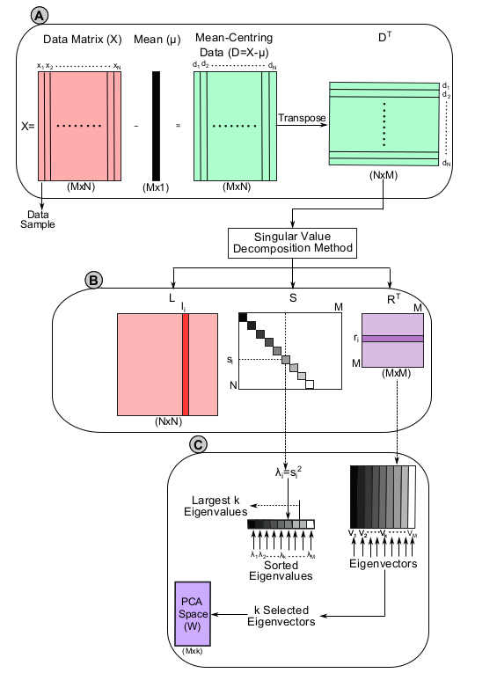

Slide 25
Uses
Binary data
Ordinal data
Compositional data
Discrete data
Symbolic data
Data with spatial structure

Slide 26
Uses and its adaptations
To decompose G matrix in order to visualize genetic distance and relatedness between individuals
Chemical spectroscopy (functional PCA)
Image processing, ML, bioinformatics and Web data analysis (robust PCA)
Signal processing (Karhunen-Loeve transformation (KLT))
Mechanical engineering (proper orthogonal decomposition (POD))
Meteorological science (empirical orthogonal function (EOF))
Interval data and histograms (symbolic data PCA)
Notes:
EOF -
Functional PCA
Robust PCA – insensitive to outliers
<number>

Slide 27
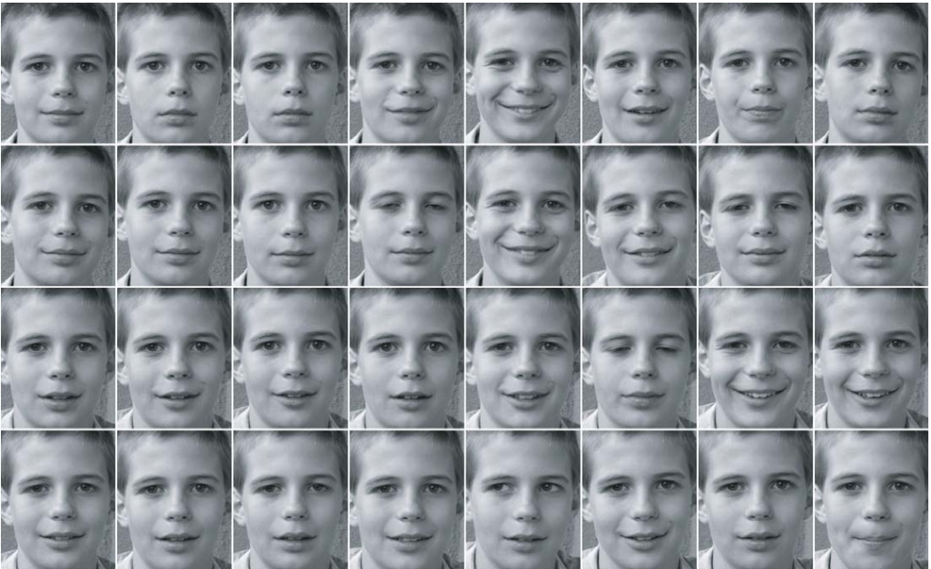
Uses
Image analysis / compression
Václav Hlaváč, Czech Technical University in Prague

Slide 28
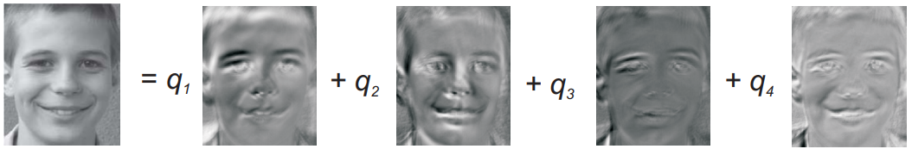
Uses
First four PCs

Slide 29
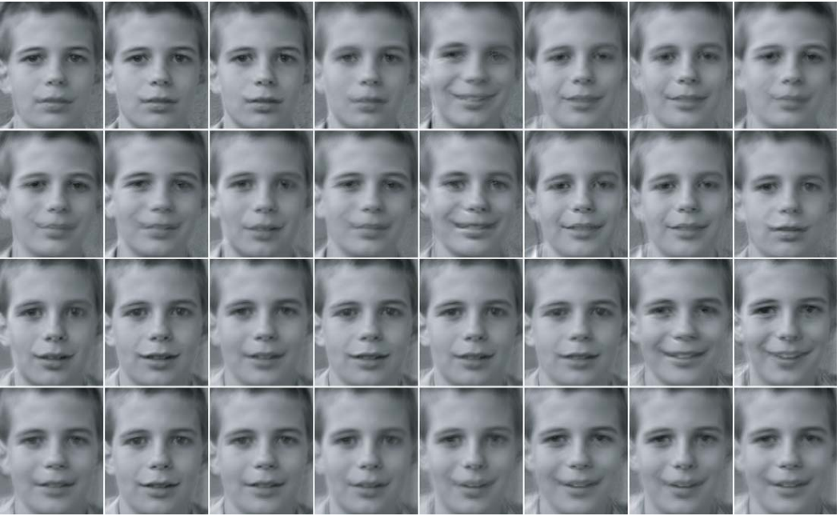
Uses
Reconstruction with 4 PC

Slide 30
Uses
Novembre et al., 2009:
https://www.ncbi.nlm.nih.gov/pmc/articles/PMC2735096/

Slide 31
Advantages / Disadvantages
Removes correlated features Improves algorithm performance Reduces overfitting Improves visualization Unsupervised technique Not computationally intensive | Independent variables become less interpretable Data standardization is a must before PCA Loss of information Systematic experimental artefacts correlations (e.g. genotyping) Maybe not the most powerful method The covariance matrix is difficult to be evaluated in an accurate manner
Notes:
http://theprofessionalspoint.blogspot.com/2019/03/advantages-and-disadvantages-of_4.html
<number>

Slide 32
R Examples
Simple SVD example
Dataset example
Image compression example

Slide 33
Helpful literature
https://stats.stackexchange.com/questions/2691/making-sense-of-principal-component-analysis-eigenvectors-eigenvalues
SVD: https://www.youtube.com/watch?v=P5mlg91as1c
https://www.youtube.com/watch?v=UyAfmAZU_WI
Eigen stuff: https://www.youtube.com/watch?v=PFDu9oVAE-g&t=441s
Paper: https://www.ncbi.nlm.nih.gov/pmc/articles/PMC4792409/pdf/rsta20150202.pdf
Tutorial: https://www.researchgate.net/publication/309165405_Principal_component_analysis_-_a_tutorial

Slide 34
Confusing terminology
Singular value decomposition: matrix factorisation into three smaller matrices (UDV^{T})
Eigen decomposition: decomposes a square matrix into eigenvector (elements are PC loadings) - eigenvalue (λ_{i}) pairs:
Ax = λx
Principal component: axis of the largest variance of the data
Principal component analysis: dimensionality reduction method, linear combinations of the centered variables
Orthogonal vectors: dot product is 0
Unit vector: vector of (Euclidian) length 1
Orthonormal: orthogonal and unit vectors

